Slide 1

Parent Pal
Parenting Made Easier

Slide 2
Team Members
Fady Ashraf Helmy | 20206052
Nour Allah Yasser Abdellah | 20206084
Mariam Ali Mohamed | 20206072
Abd El Rahman Moataz Mohamed | 20196032
Adham Hany Abbas | 20208006
Supervised by
Dr. Fatma Omara, Dr. Doaa Saleh, TA. Ashraf Mohey

Slide 3
Table of Contents
01.
02.
Project Idea
Problem Significance
03.
04.
Project specifications
Work Plan
05.
06.
Conclusion
Diagrams
07.
08.
Demo
Poster

Slide 4
01. Project Idea
Parent Pal is a mobile application designed to assist parents in navigating the complexities of parenting. Our domain of interest is family and child development.

Slide 5
02. Problem Significance

Slide 6
Survey Responses
Ages of people responded to our survey

Slide 7
Survey Responses
Do you think that there is a lack of information available to parents regarding proper education and care for children?

Slide 8
Survey Responses
Do you need more information about raising and caring for children?

Slide 9
Survey Responses
Do you think there is a need to conduct special initiatives or programs to educate parents about proper parenting and childcare?

Slide 10
Survey Responses
Resources used to obtain information about raising and caring for children

Slide 11
Some Problems Facing Children
Parental Influence and Engagement:
Lack of sufficient parental attention and time for dialogue.
Parental neglect and negative comparison.
Difficulty in parents understanding their children's needs.
Pressure from parents and their absence in emotional support.
Peer and Social Pressures:
Influence of peers and negative friends.
Bullying and peer pressure.
Impact of social media and negative online interactions.
Behavioral and Emotional Challenges:
Difficulty in expressing emotions.
Dealing with strong emotions and anger.
Challenges in self-expression and communication with parents.
Cultural and Environmental Factors:
Impact of community and cultural differences.
Negative habits learned from social media and television.
Unhealthy family environment and marital issues affecting children.
Education and Values:
Importance of instilling good morals and ethics.
Teaching children right from wrong.
Challenges in applying learned principles in real-life situations.

Slide 12
Some Problems Facing Parents
Media and Technology Influence: Balancing children's exposure to electronic screens and mobile technology with healthy activities.
Peer Pressure and Social Media: Dealing with negative influences from peers and social media platforms.
Time Constraints: Finding sufficient time to spend with children amid busy schedules and societal demands.
Educational and Cultural Challenges: Teaching children values and ethics in a rapidly changing world with diverse cultural influences.
Financial Pressures: Coping with financial pressures that affect parenting and family dynamics.
Parental Communication and Understanding: Establishing trust and effective communication channels with children, especially during adolescence.
Behavioral Correction: Correcting inappropriate behavior influenced by external factors like media and social environments.
Educational Guidance: Providing proper guidance and support in educational and career decisions.
Negative Societal Influences: Protecting children from negative societal behaviors and beliefs.
Lack of Parental Awareness: Addressing challenges due to parents' lack of awareness or understanding of modern parenting techniques.

Slide 13
Common Issues Among Children
Psychological and Behavioral Issues:
Autism
ADHD, Hyperactivity, Lack of concentration
Depression & Anxiety
Stubbornness, Violence, Anger, Lying, Aggression, Defiance
Isolation, Lack of self-confidence, FOMO (Fear of Missing Out), Loneliness
Addiction to mobile phones and internet, Negative influence of social media, Behavioral disorders due to wrong upbringing
Common Infectious Diseases:
Common cold, Flu, Seasonal flu, Tonsillitis, Otitis, Bronchitis
Diarrhea, Stomach flu, Gastrointestinal problems
Measles, Chickenpox, Jaundice, Meningitis
Chronic and Genetic Conditions:
Respiratory allergies, Asthma
Down syndrome
Nutritional and Growth Issues:
Malnutrition, Poor nutrition, Vitamin deficiencies
Delayed growth, Stunted growth
Obesity, Overweight, Sedentary lifestyle
Environmental and Lifestyle Factors:
Hygiene-related Diseases
Impact of Environment

Slide 14
Common Issues Among Children
Neurological and Developmental Disorders:
Stuttering, Speech delay
Developmental disorders, Delayed milestones
Immune System and Other Health Conditions:
Weak immunity, Frequent infections, Autoimmune diseases
Headaches, Fever, Dental problems (tooth decay), Eczema, Psoriasis
Psychosocial and Family Issues:
Lack of proper role models, Misguided upbringing leading to psychological issues
Issues due to family disputes, Lack of parental attention

Slide 15
Special Issues and Conditions Requiring Community Support for Children
Early Adolescence
Parental Conflicts
Support for Children of Divorce
Bullying
Building Self-confidence
Moral Values
Influence of Social Media
Special Needs Children
Teenage Relationships
Autism Awareness.
Work of Parents
Positive Role Models
Mental Health Support
Refugee Children
Child Labor
Children's Privacy
Health Crises and Environment
Children in Poverty
Violence and Exploitation
Educational Support
Sexual Education and Health
Children's Nutrition
Orphaned and Homeless Children
Drug Addiction
Gender Issues
Domestic Violence
Disability Awareness
Public Health Education

Slide 16
Problem to Solve
The lack of centralized guidance and support for parents facing diverse parenting challenges.

Slide 17
Why and How?
We aim to empower parents with a versatile tool that identifies specific problems and offers tailored solutions and resources. Through a user-friendly mobile app, we provide comprehensive guidance, evidence-based strategies, and dedicated support for special needs.

Slide 18
Previous Solutions
Existing solutions include parenting forums, apps, websites, and behavioral parenting apps. However, they often lack structured and curated content, evidence-based strategies, and a user-friendly interface, leaving parents feeling overwhelmed and isolated.

Slide 19
Educational Parenting Websites
Zero to Three
HealthyChildren.org
Behavioral Parenting Apps
Parenting Hero
Parenting Counts
Parenting Apps
The Wonder Weeks
Baby Tracker
Related Work
Special Needs Parenting Communities
Understood
MyAutismTeam
Parenting Forums
BabyCenter
What to Expect

Slide 20
03. Project Specifications

Slide 21
Stakeholders
Parents & Caregivers
Children
Experts & Professionals
Special Needs Advocacy Groups
App Administrators.
Non-Functional Requirements
Performance
Security
Scalability
Usability
Reliability
Data privacy.

Slide 22
Features & Functional Requirements
Essential Features
User Authentication (Sign In & Sign Up)
Parenting Topics Categorization
Core Features
Supplemental Features
Nutrition and Tips for Each Pregnancy Stage
Progression to Toddlerhood Advice
Special Needs Section
Articles, Discussions & Media
Emergency Reference
Q&A with Consultants and Therapists
Interactive Tools
Activity Suggestions
Bedtime Stories
School Suggestions
Daily Notifications

Slide 23



Technologies Used
Our Project is developed using Flutter and Dart for cross-platform compatibility and efficient development. Integrated with Firebase for real-time updates, secure data storage, and collaborative features.

Slide 24
SWOT Analysis
Strengths
Weaknesses
Comprehensive Support
Expert Guidance
User-Friendly Interface
Real-time Updates
Community and Interaction
Resource Intensive
Data Privacy Concerns
User Engagement
Opportunities
Threats
Market Demand
Expansion
Partnerships
Competition
Regulatory Challenges
Technological Changes

Slide 25
04. Work Plan

Slide 26
Task Title | Description | Task Status
Survey | Survey You Have Conducted To Determine Your Project Idea And Children Problems | Completed
Research Project | Conduct Research On Parenting Challenges And Existing Solutions | Completed
Write Abstract | Write Abstract Describing The Project Idea And Motivation | Completed
Background Introduction | Draft Background Section Introducing The Project Domain | Completed
Identify Beneficiaries | Identify Primary Beneficiaries Of The Project | Completed
Choose Tools And Technologies | Select Flutter, Dart, And Firebase For Implementation | Completed
Problem Definition | Draft Problem Definition Section | Completed
Review Existing Solutions | Research Existing Parenting Apps And Forums | Completed
Identify Differences | Analyze Differences Between Existing Solutions And Project | Completed
Project Specifications | Draft Project Specifications Section | Completed
System Architecture Design | Design System Architecture For The Application | Completed
Identify Stakeholders | Identify Stakeholders Involved In The Project | Completed
Functional Requirements | Outline Functional Requirements For The Application | Completed
Non-Functional Requirements | Outline Non-Functional Requirements For The Application | Completed
Use Case Diagram | Create Use-Case Diagram For The Application | Completed
Class Diagram | Create Class Diagram For The Application | Completed
Sequence Diagrams | Create Sequence Diagram For The Application | Completed
ERD | Develop Entity Relationship Diagram For Database | Completed
Presentation | Write Content For Project Presentation | Completed
Code | Implement Project Code Using Flutter, Dart & Firebase | Completed
Poster | Design Project Poster | Completed
Use Case Narratives | Write Use case narratives for each use case | Completed

Slide 27
05. Conclusion
Parent Pal aims to revolutionize the way parents approach parenting challenges by providing a comprehensive and user-friendly solution.
By addressing the lack of centralized guidance, offering evidence-based resources, and catering to special needs, we strive to create a supportive and informed parenting community.
With our innovative approach and dedication to empowering parents, we aim to make a positive impact on families worldwide.

Slide 28
06. Diagrams

Slide 29
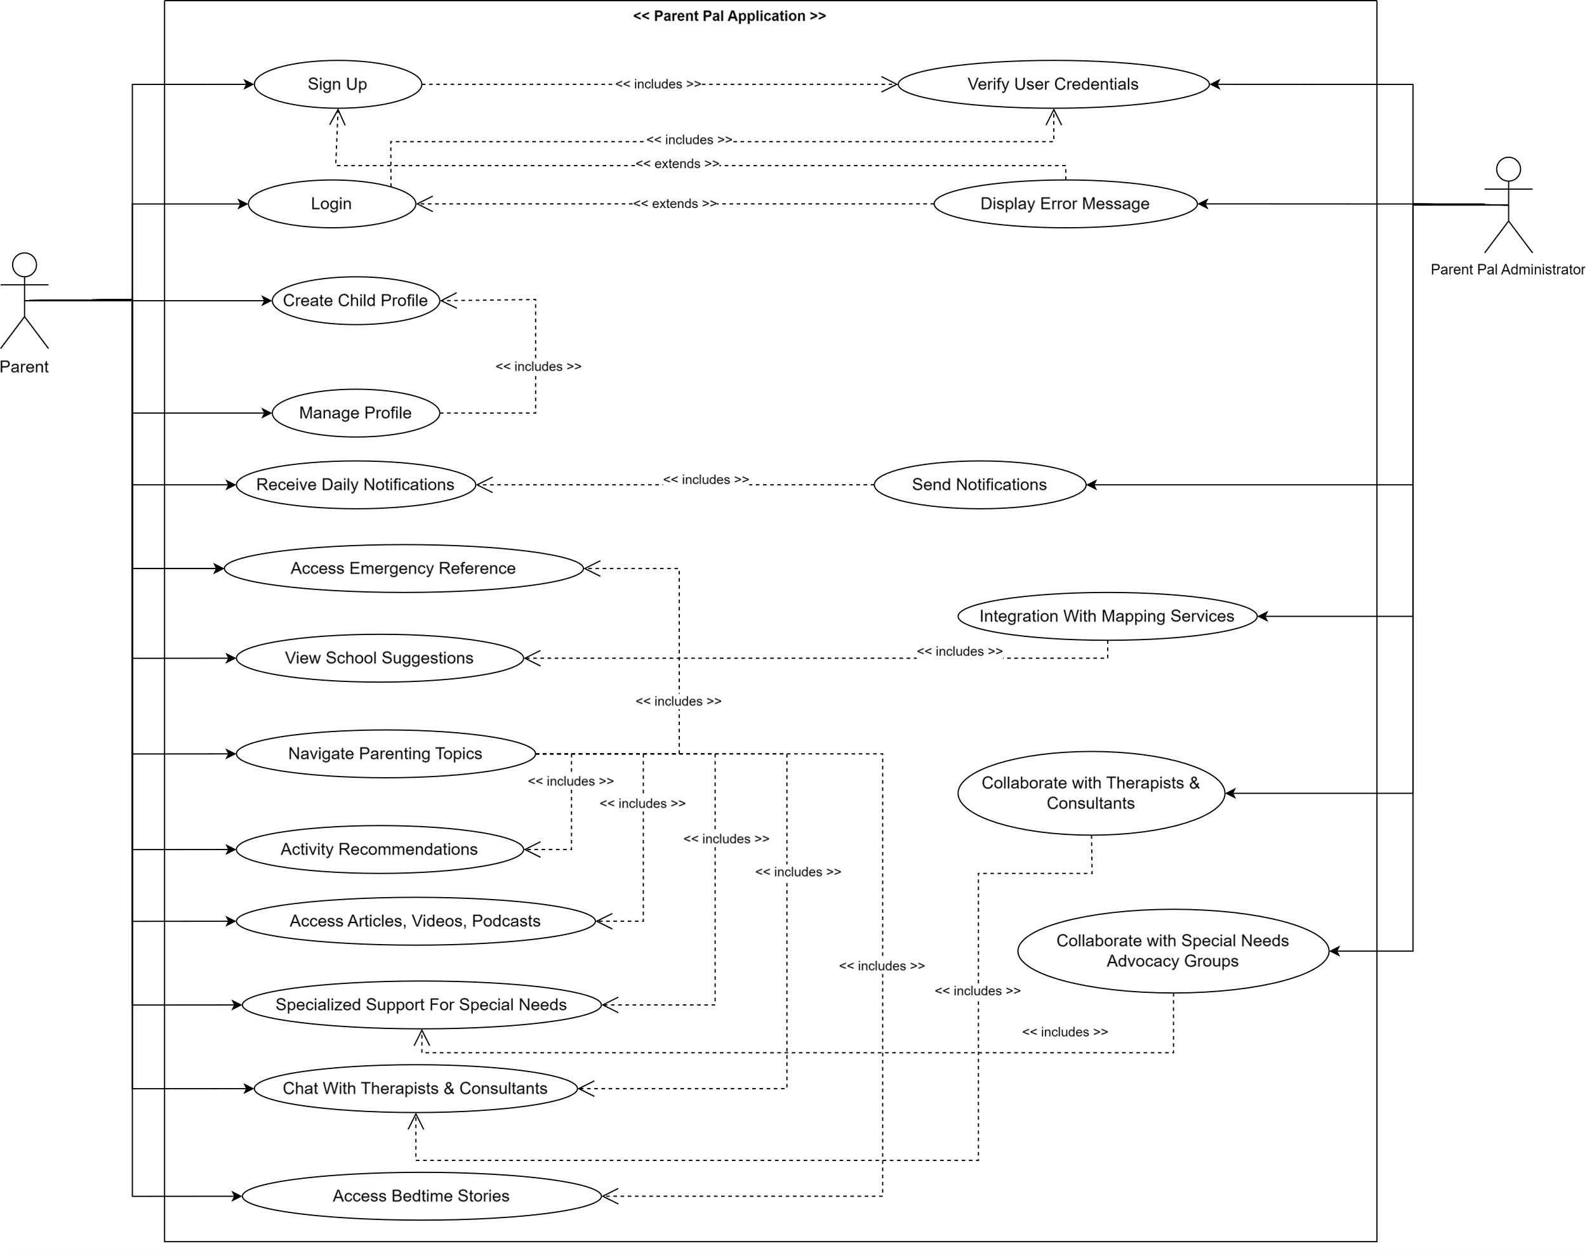

Slide 30
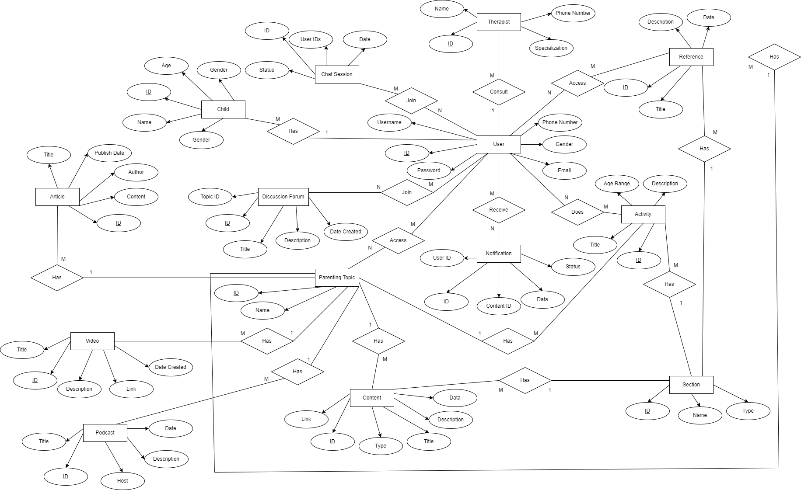

Slide 31
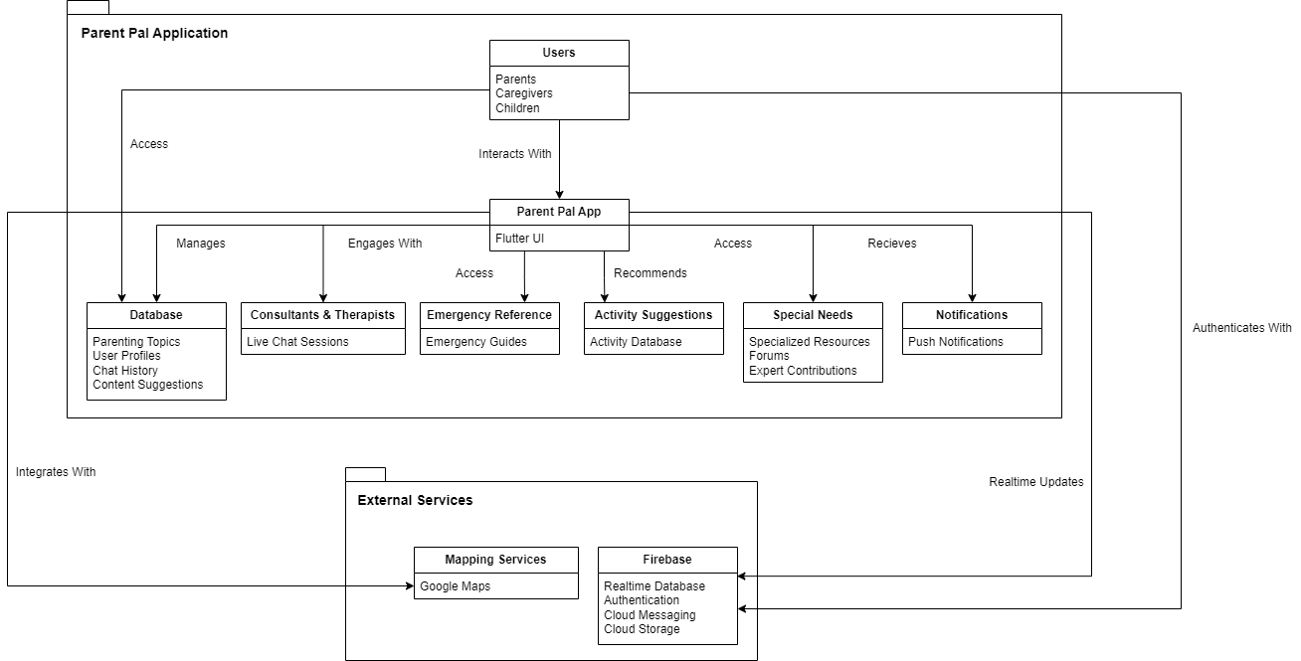

Slide 32
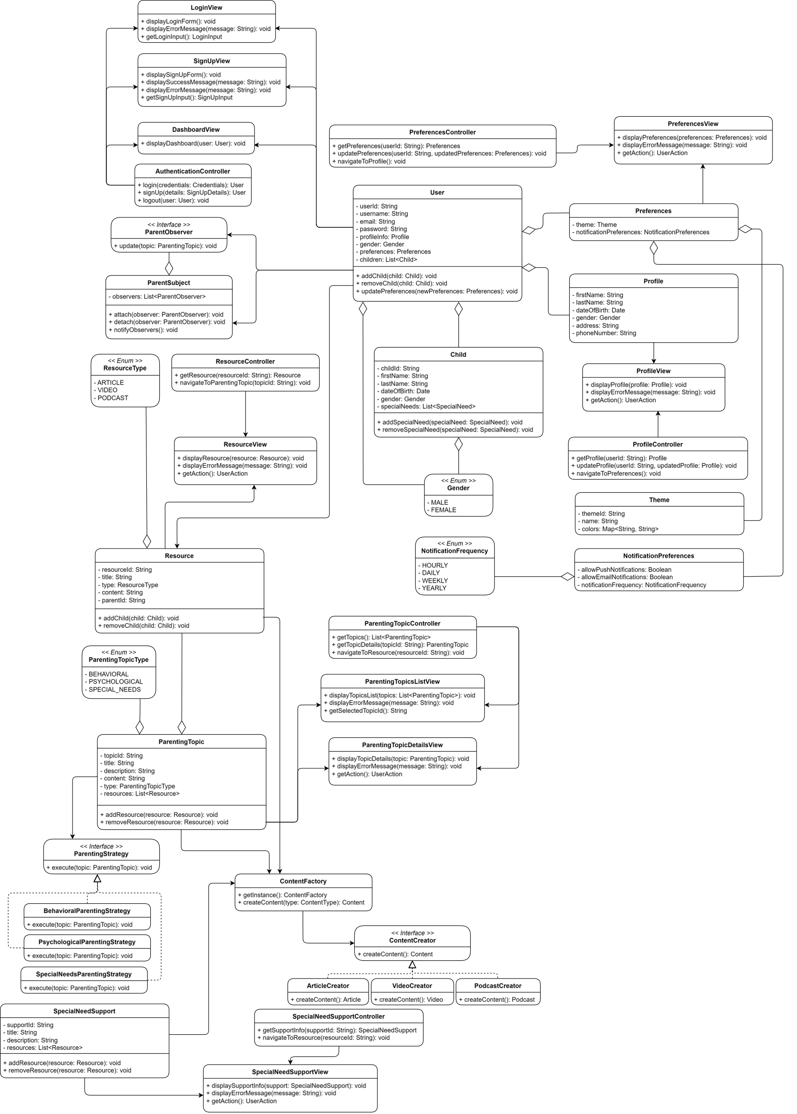

Slide 33
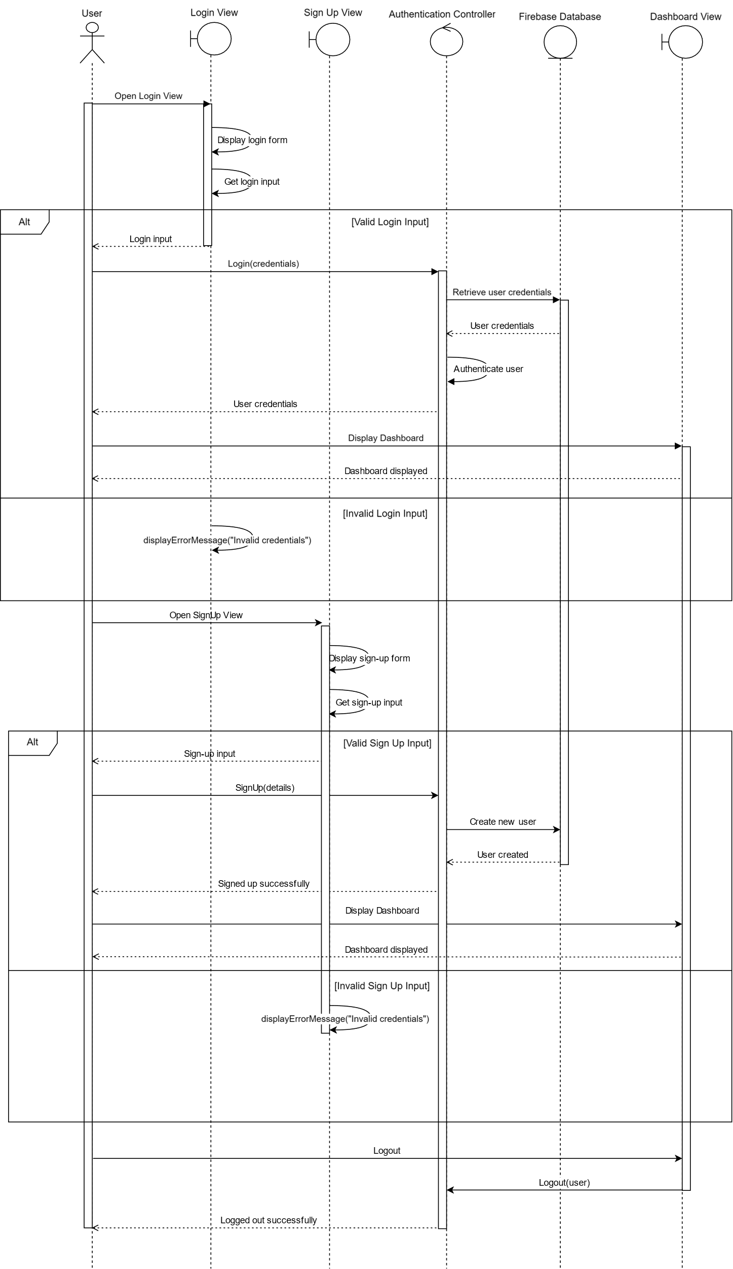
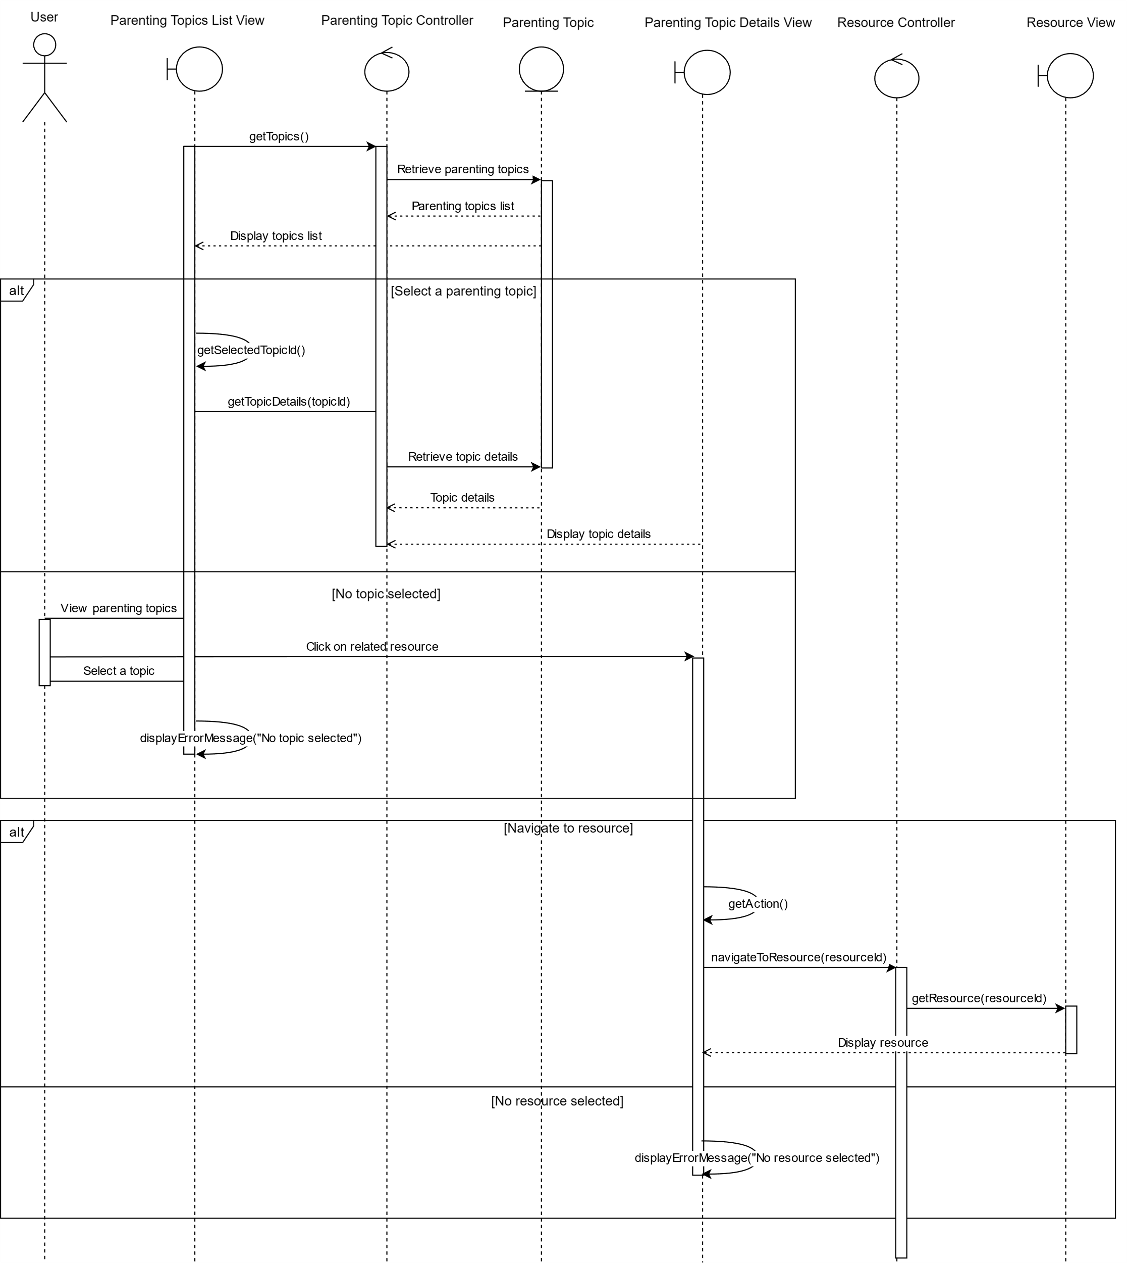

Slide 34
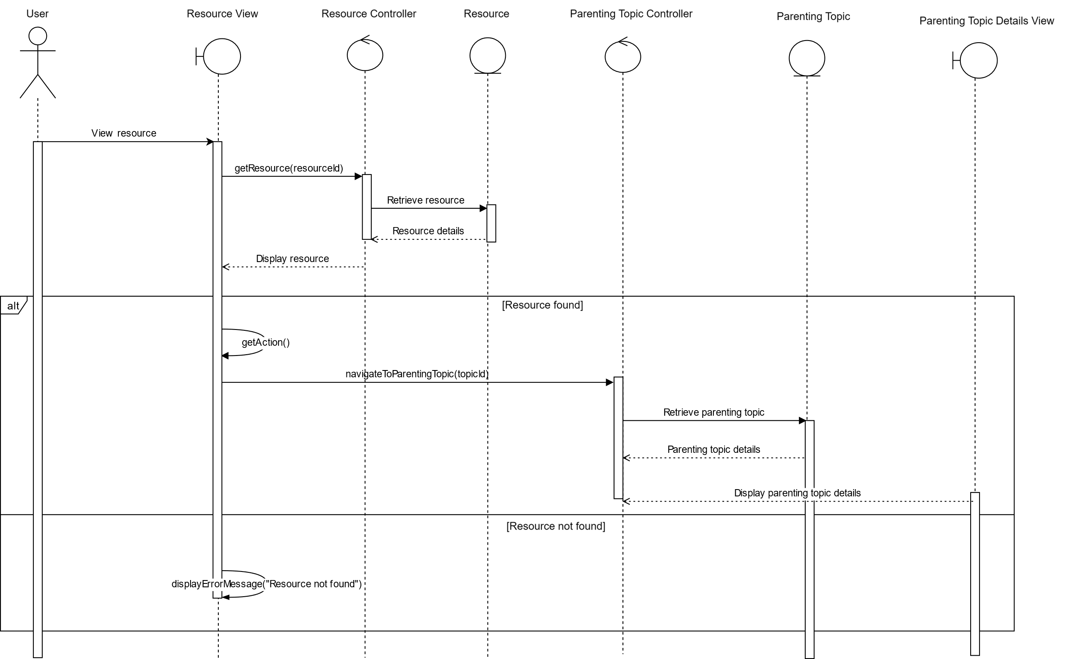

Slide 35
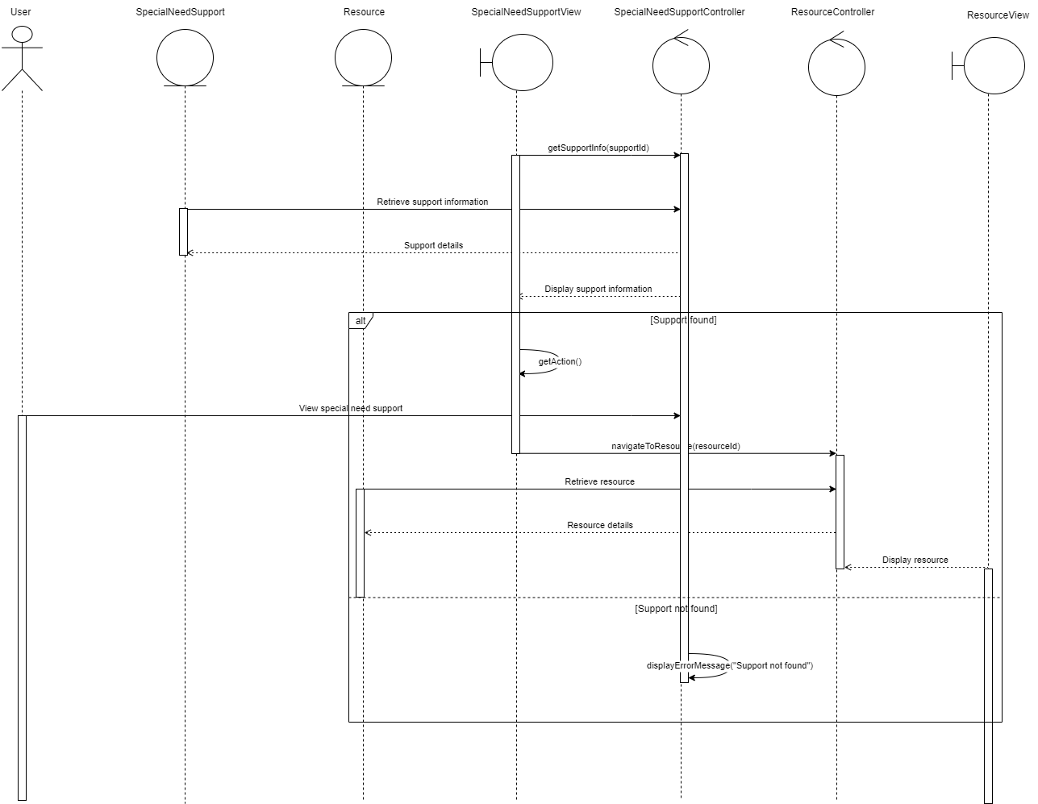

Slide 36
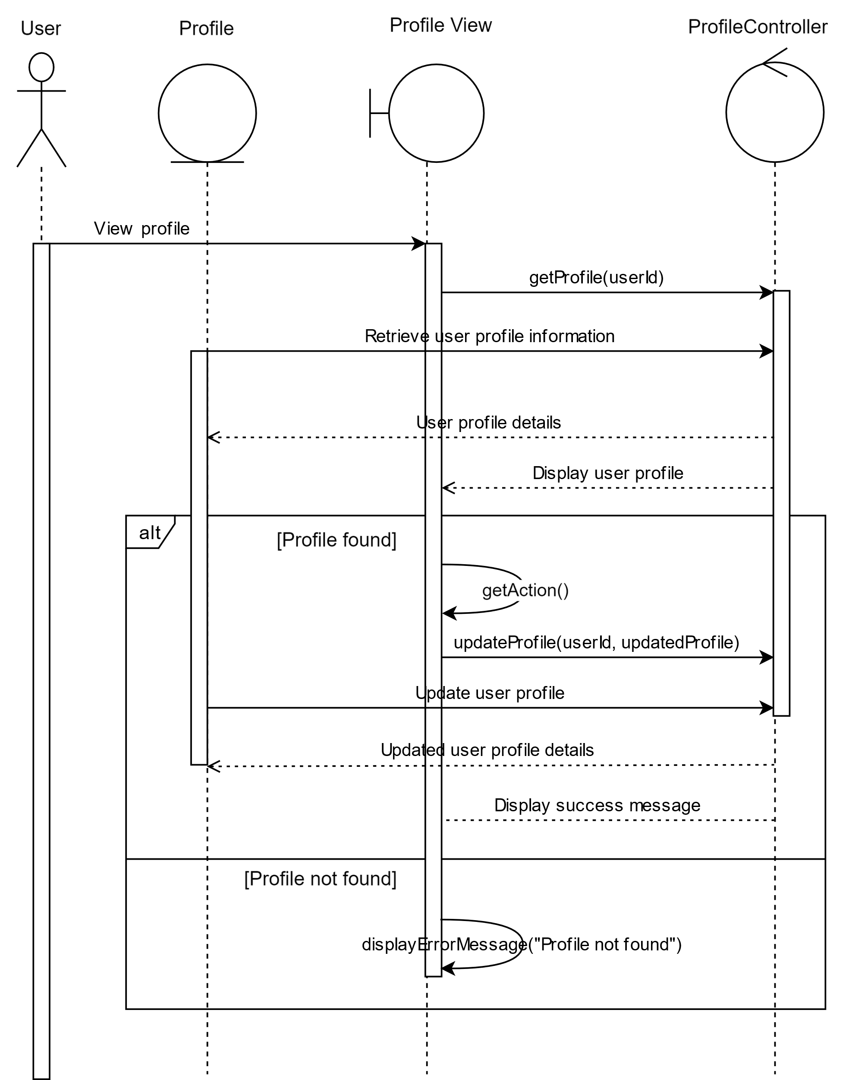
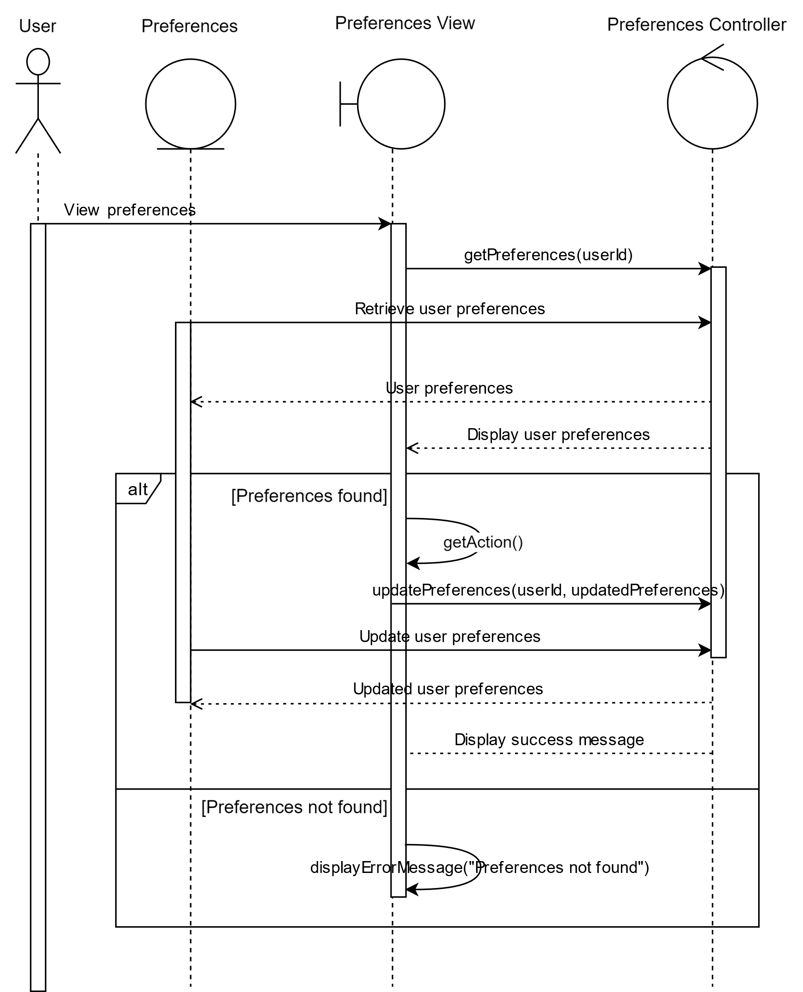

Slide 37
07. Demo

Slide 38
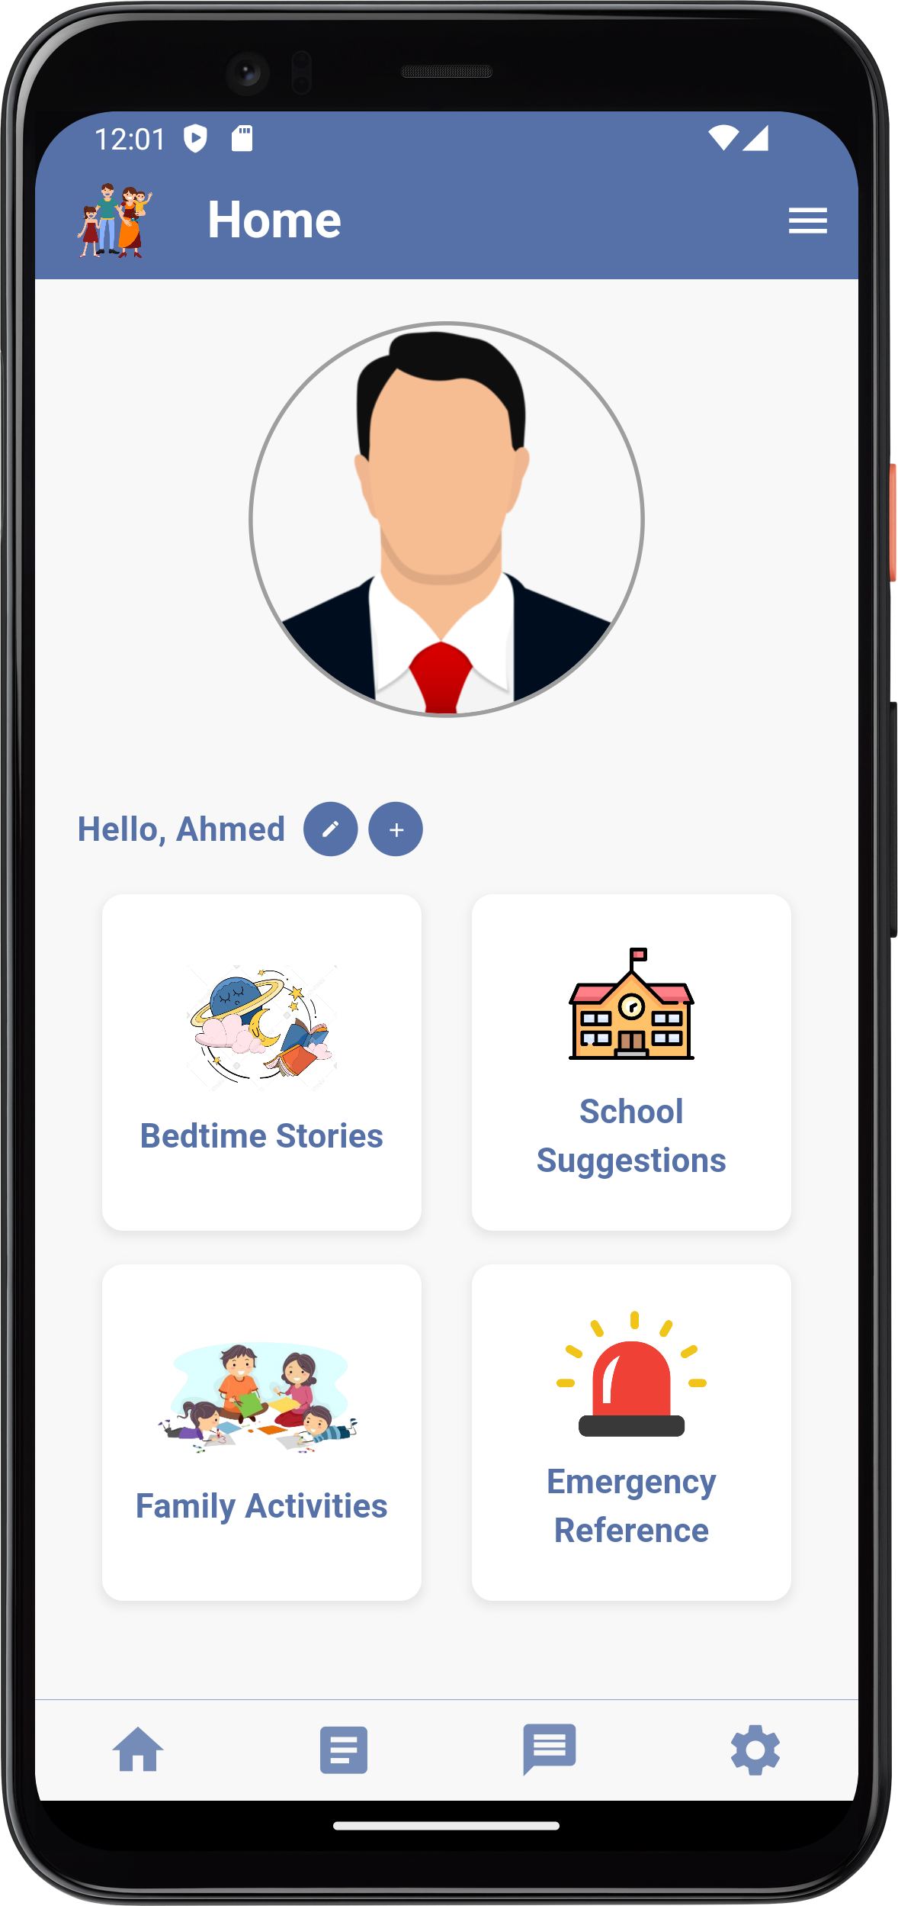
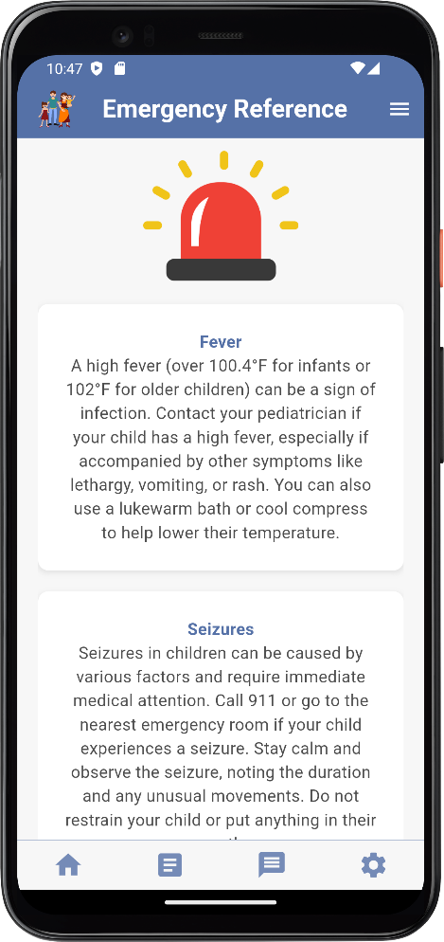
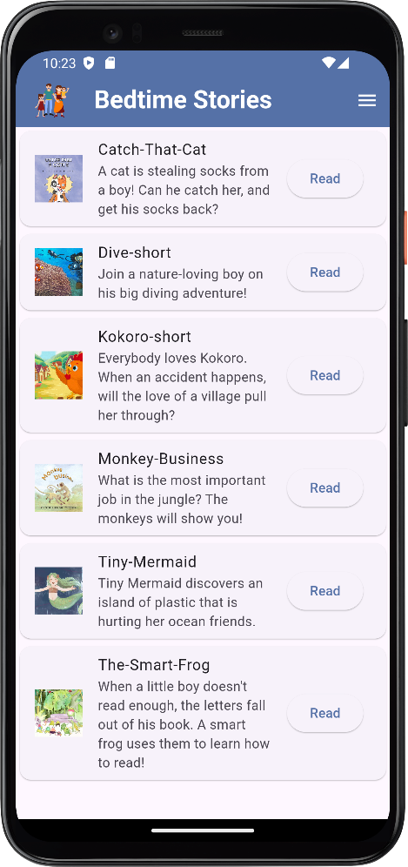

Slide 39
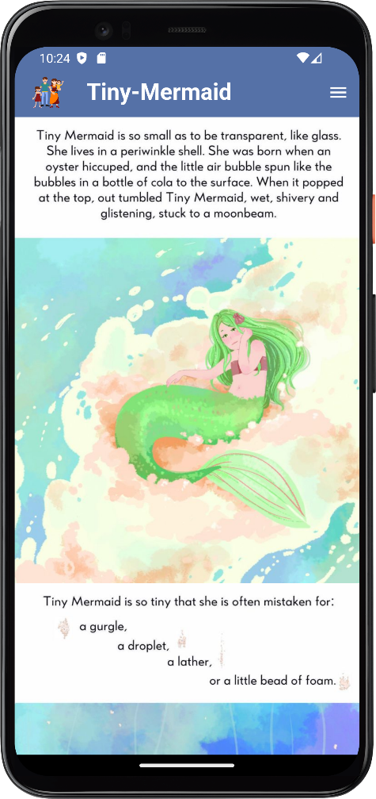
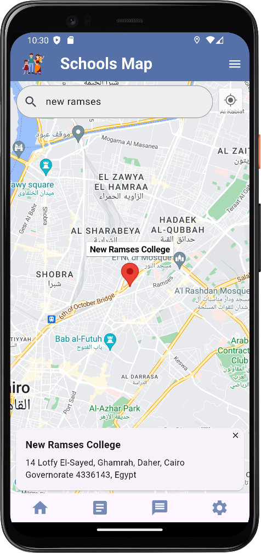
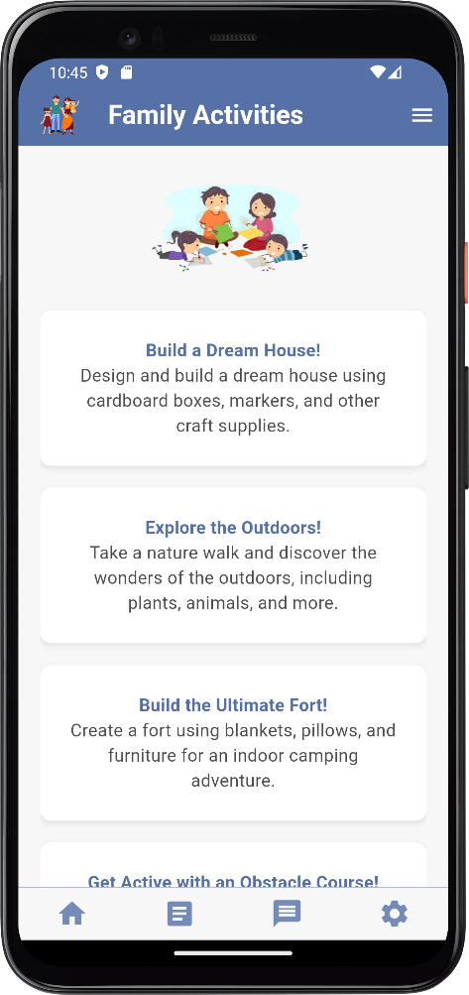

Slide 40
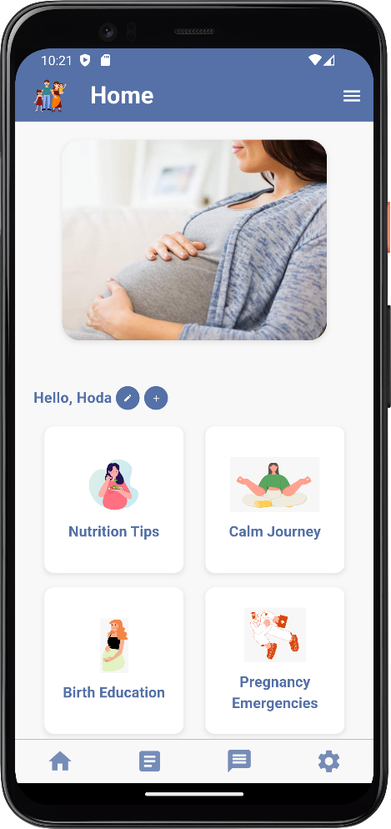
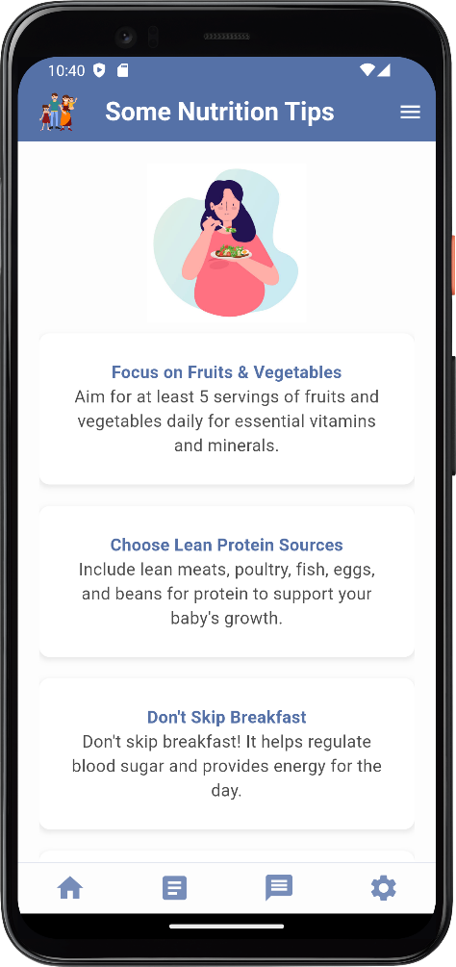
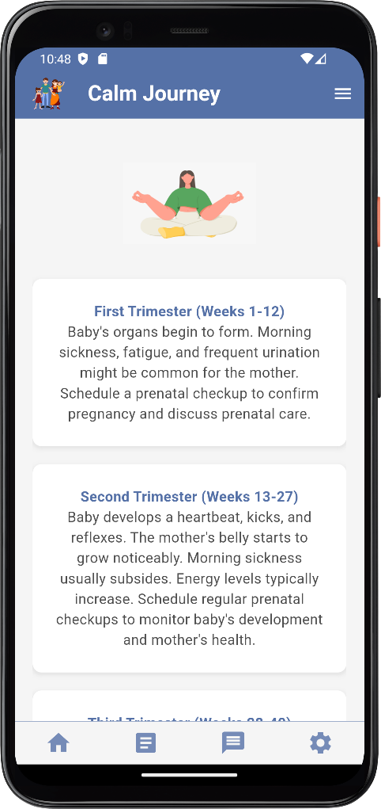

Slide 41
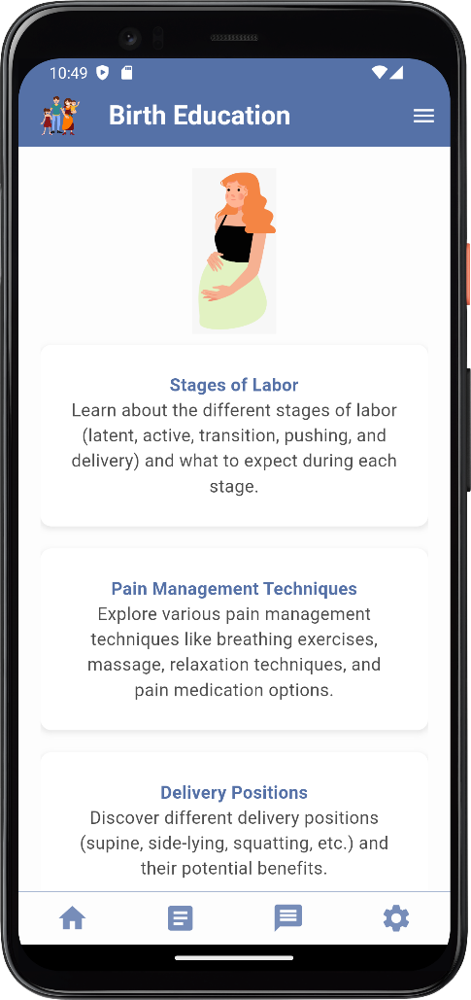
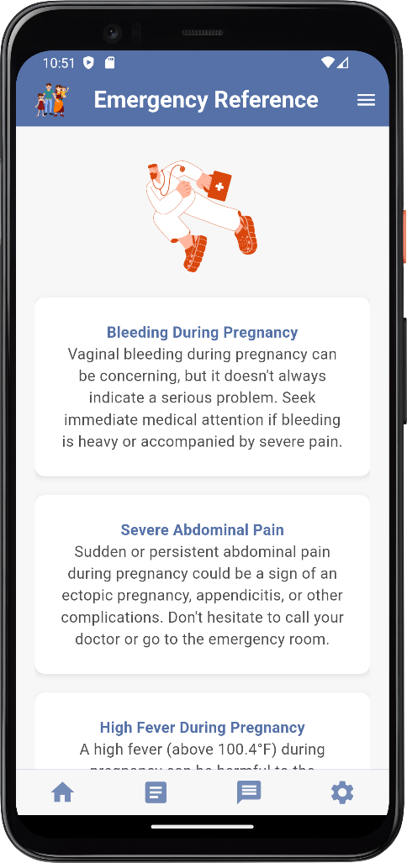
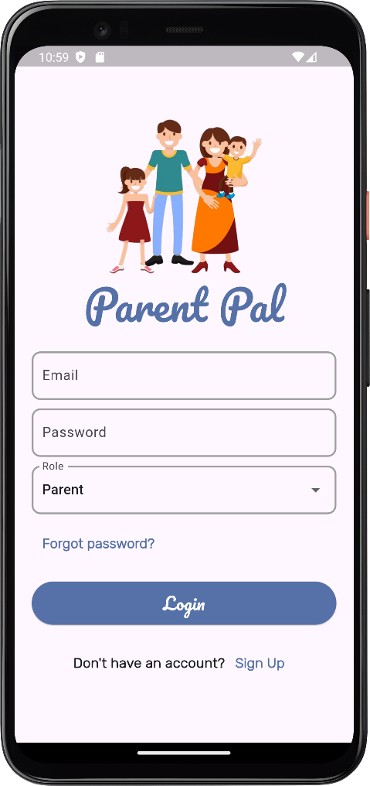

Slide 42
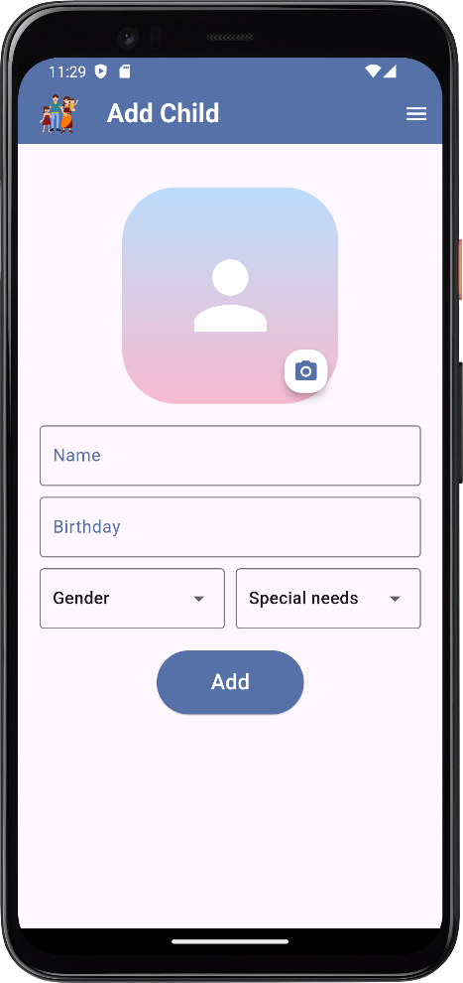
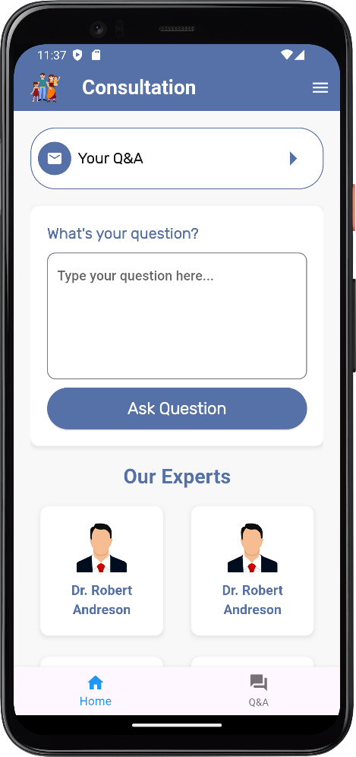
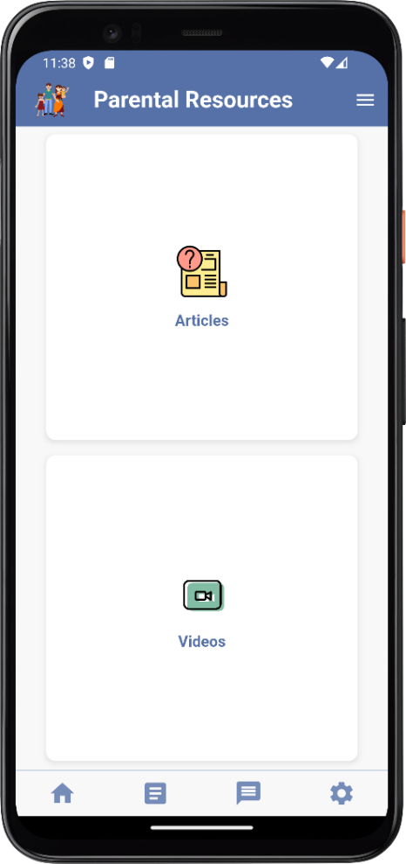

Slide 43
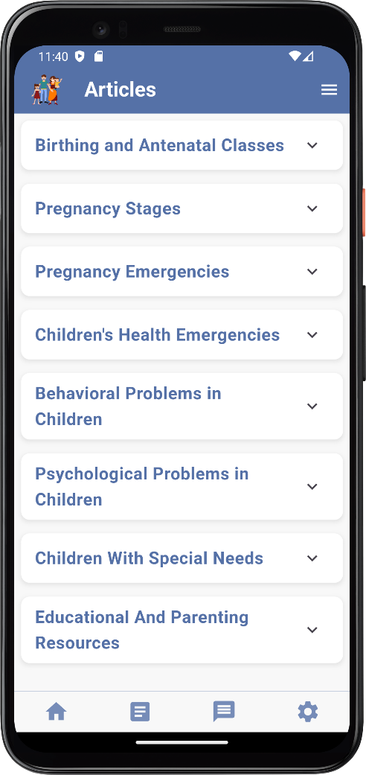
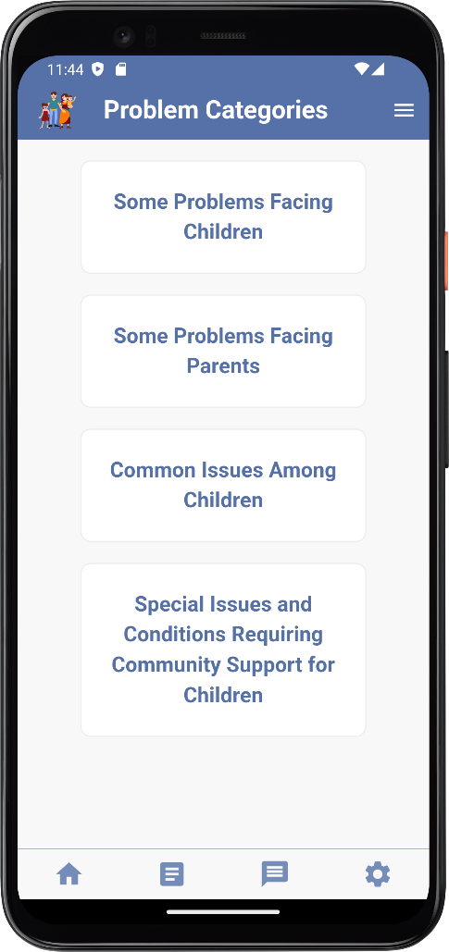
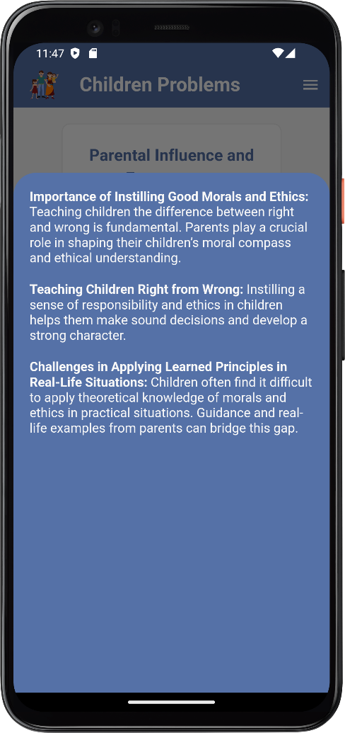

Slide 44
08. Poster

Slide 45
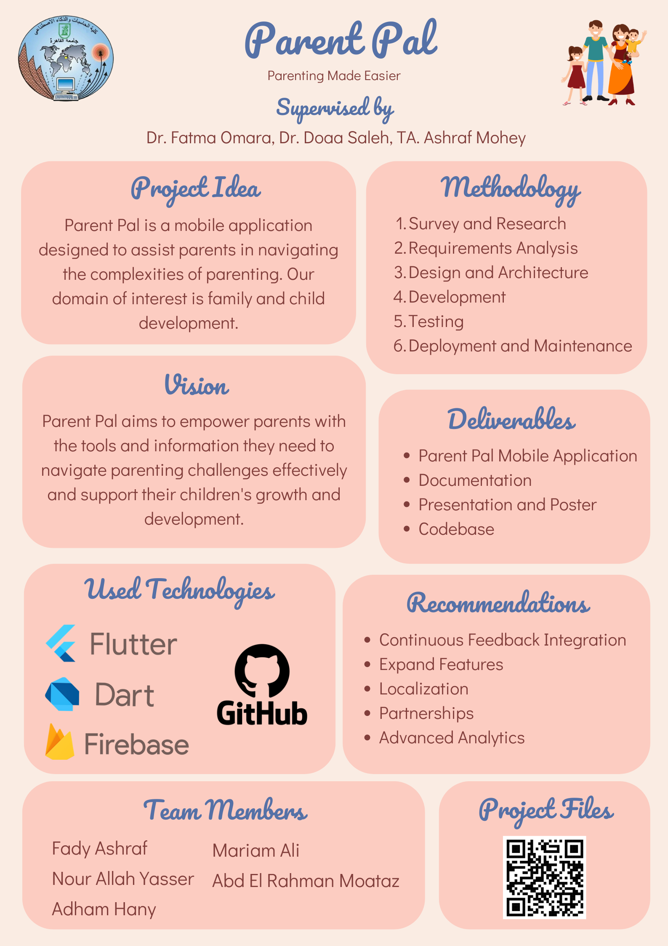

Slide 46
Thank You!

